Slide 1

Day 5
Finish up create your own adventure video game
Talk more about random numbers
Introduce lists

Slide 2

Choose Your Own Adventure Video Game Continued
This video game will be a choose-your-own-adventure video game (which was the first type of video game ever created)
Let’s say the user is on a deserted island looking for treasure
We’ll start by asking if the player wants to go North, East, South, or West
Hint: we can write if statements inside of other if statements

Slide 3

Random Numbers
Now we’ve created one type of video game, but other types of video games might need some aspect of randomness to them
Like what loot a monster will drop when defeated or what's in a chest
To add randomness to our games and programs, we will need to create random numbers
There are two types of random numbers in Python: randint (random whole numbers) and random (random decimal numbers)

Slide 4
Import Statements
Before we tell Python to give us a random number, we need to tell Python how to create a random number because Python doesn’t know how to do that
We can give Python the instructions to generate random numbers using an import statement.
This imports the instructions on how to get a random number into our program
We will need to do this in every program where we use random numbers
We can do this by typing
import random

Slide 5

RandInt
We can generate a random whole number like this:
random_number = random.randint(min, max)
This will give us a random number between 1 and 5:
random_number = random.randint(1, 5)
We can use the type() function to check what type of number randint gives us (whole number or decimal number)
print(type(random_number))
This will sow us that the number is an integer (whole number)

Slide 6

Random
We can generate a random decimal number like this
random.random()
This will give us a random decimal (float) number between 0 and 1
But what if we want a random decimal number that’s not between 0 and 1?
Then we can do this:
random.random() * (max - min) + min
For example, this will give us a random decimal number between 1 and 5:
random.random() * (5 – 1) + 1
Try it out

Slide 7
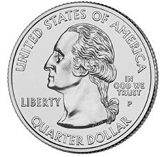
Random Numbers in Programs
Let’s try writing a program that flips a coin and tells the user if they got heads or tails based on a random result.
First, we need to get a random number
result = random.randint(0, 1)
Then we need to check what the number is to find if its heads or tails
(0 is heads, 1 is tails)
if result == 0:
print(“Heads”)
else:
print(“Tails”)

Slide 8
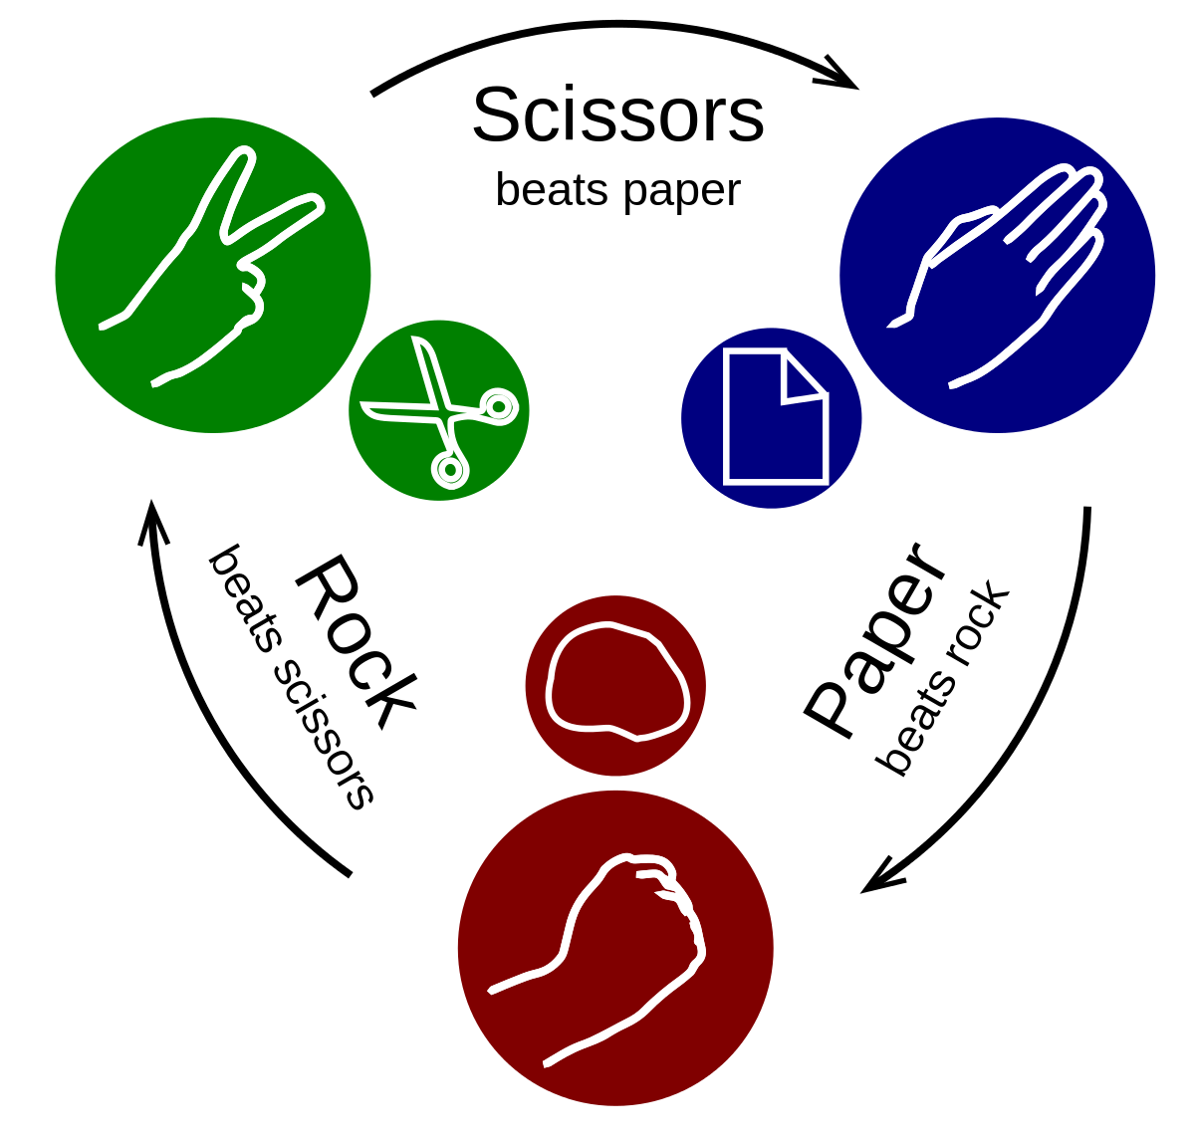
Project: Rock Paper Scissors
We can make a more fun version of our coin flip program by turning it into a rock-paper-scissors game where the user competes against the computer
The user would enter “rock” “paper” or “scissors” and the program would also choose “rock” “paper” or “scissors” based on a random number
Hint: use random.randint(1, 3) and if, elif, and else statements

Slide 9

Lists
Do you remember in our first class when we printed out a shopping list?
We had to write many lines of code to write the list
What if we wanted to store a whole bunch of related variables in one place?
It’d be difficult to write a variable for 10 or 100 different variables in a list
item_1 = “apples”
item_2 = “oranges”
item_3 = “93 bags of ice”

Slide 10
We can make this easier using something in Python called a List
Lists can hold a bunch of variables like Strings, Ints, Floats, and even other Lists
We create a list like this:
list = [item1, item2, item3 …]
list = [] creates an empty list
Let’s try creating another shopping list
shopping_list = [“apples”, “oranges”, “93 bags of ice”]
Try printing the shopping list and see what happens
print(shopping_list)

Slide 11

Accessing an Element of a List
What if we just want the 3rd element in the list?
We can try writing:
shopping_list[3]
Now, you might notice that if we write print(shopping_list[3]), it actually prints the 4th item in the list
This happens because programmers count the index (placement) of items in lists starting from zero
So, if we pant to get the third item in the list, we need to write:
shopping_list[2]

Slide 12
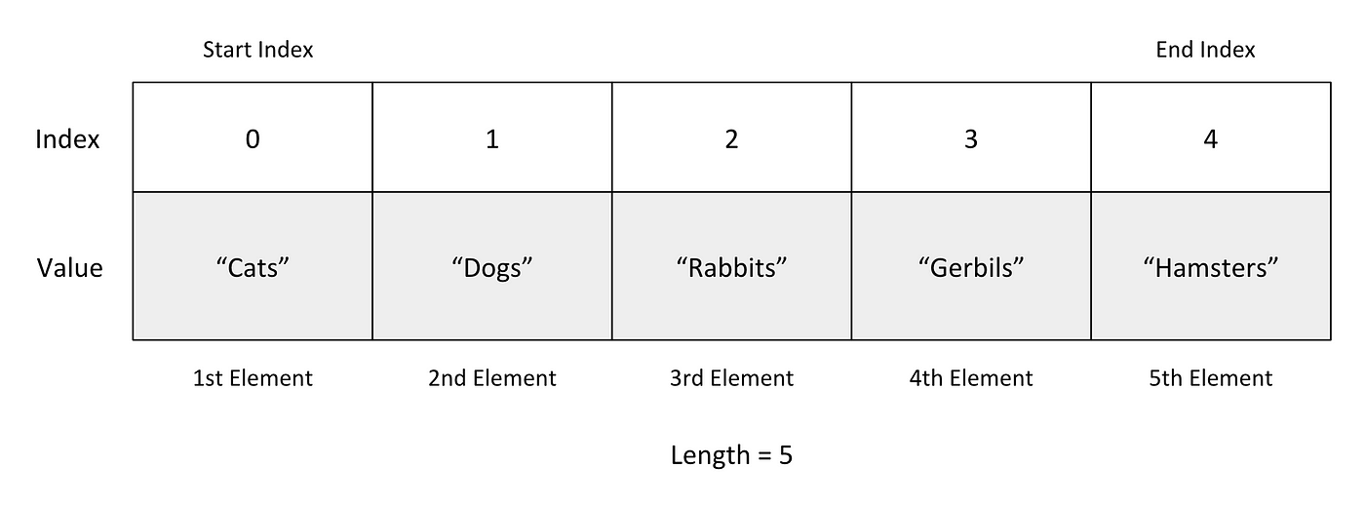

Slide 13
Index Errors
What if we try accessing an element that does not exist?
Like trying to access item 200 of a 10-item long list
Try writing:
shopping_list[199]
In this case we get an error.
A more normal situation where we get this error is when we are trying to access the last item in a list
Like trying to access item 10 of a 10-item list
If we write list[10] we get an error because indexes are counted starting from 0, so the 10th index doesn’t exist. Instead, we need to write list[9]

Slide 14
Append, insert, and remove
What if we want to change what’s in a list after it’s been created?
Then we can use the append(), insert(), and remove() methods
For example:
To add grapes to the end of the shopping list:
shopping_list.append(“grapes”)
To add strawberries at the first item (at index 0) in the list
shopping_list.insert(0, “strawberries”)
To remove apples from the list:
shopping_list.remove(“apples”)
Notice what happens if we try to remove something that doesn’t exist
shopping_list.remove(“beets”)
We get an error

Slide 15
Len
We can get the length of the list using the len() method
len(shopping_list)
We can use this to always get the last item in the shopping list like this:
last_item = shopping_list[len(shopping_list) – 1]
Remember to add the -1 because lists start from 0

Slide 16
How to Change an Element of a List
What if we want to change the first item of the shopping list to socks?
Then we would “reassign” the first item of the list
Like this:
shopping_list[0] = “socks”
Try it out

Slide 17

Project: User’s Shopping List
Let’s turn our shopping list code into a function and let’s fill up the shopping list using user input
First, create an empty list:
shopping_list = []
Then ask the user what the first item of their list is and put their answer in the shopping list
shopping_list.append(input(“What’s the first item in the list? “))
Repeat this 3 times

Slide 18
Then print out how long the shopping list is and what the first and last items of the list are
Hint: use the len() function and list[index] to get this information

Slide 19

Project: User’s Shopping List with Random Numbers
What if we then want to tell the user which items to buy in which order
Let’s make this order random
For this we’ll have to use the random.randint() method

Slide 20
random_index = random.randint(0, 2)
item = shopping_list[random_index]
print(“First, you should buy “ + item)
shopping_list.remove(item)
random_index = random.randint(0, 1)
item = shopping_list[random_index]
print(“Next, you should buy “ + item)
shopping_list.remove(item)
item = shopping_list[0]
print(“Finally, you should buy “ + item)

Slide 21
Nested Lists
We can even create lists of lists (these are called nested lists)
Ex:
safeway_shopping_list = [“apples”, “oranges”, “17 chocolate bars”]
target_shopping_list = [“shirts”, “Pokémon cards”]
best_buy_shopping_list = [“computer”, “keyboard”, “Xbox”]
final_shopping_list = [safeway_shopping_list, target_shopping_list, best_buy_shopping_list]
Try making a list of lists and then try printing it

Slide 22
Nested Lists Continued
We can access one item of a nested list like this:
item = final_shopping_list[0][0]
This gets the 1st item of the 1st list
item = final_shopping_list[1][0]
This gets the 1st item of the 2nd list
The first number is which list the item is in and the second number is where in that list the item is

